Slide 1
E-Learning Portal Using JSP SERVLET
BY - SUBHAM ACHRYA

Slide 2
MODULES
LOGIN AND LOGOUT MODULE
ADMIN MODULE
ADMIN ADD COURSE MODULE
ADMIN DELETE COURSE MODULE
ADMIN VIEW FEEDBACK MODULE
STUDENT VIEW COURSE ALLOTTED MODULE
STUDENT FEEDBACK MODULE

Slide 3
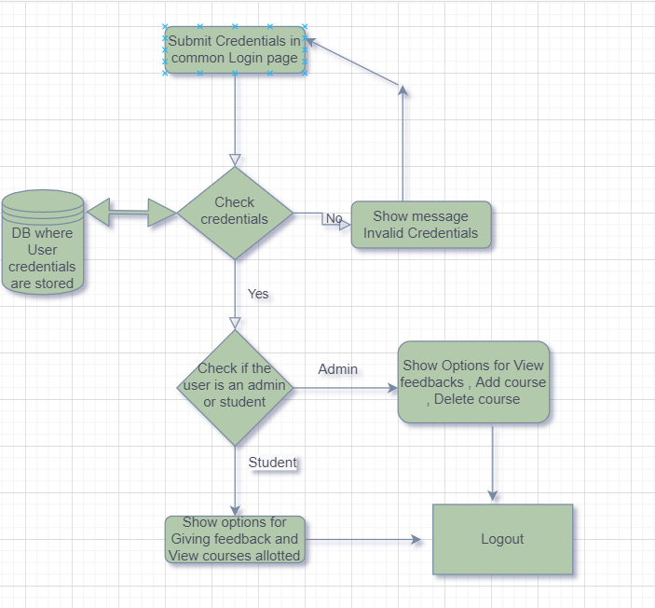
PROJECT FLOW

Slide 4
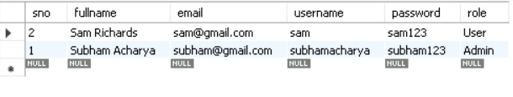
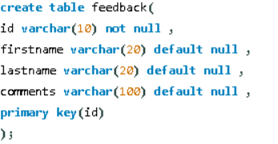
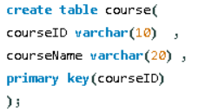
DATABASE STRUCTURES
Credentials Table
Feedback Table and Courses Table

Slide 5
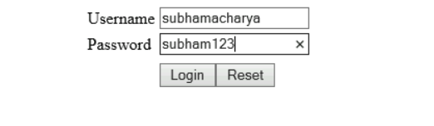
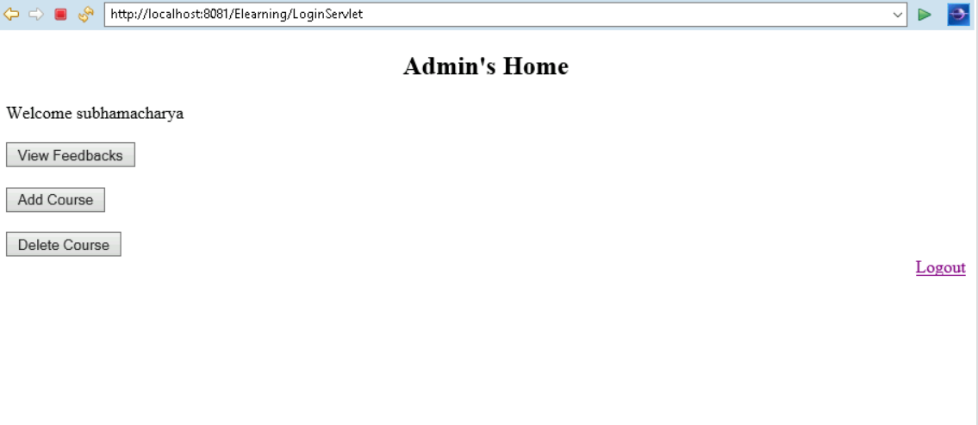
SCREENSHOTS
Login Page
Admin’s Dashboard

Slide 6
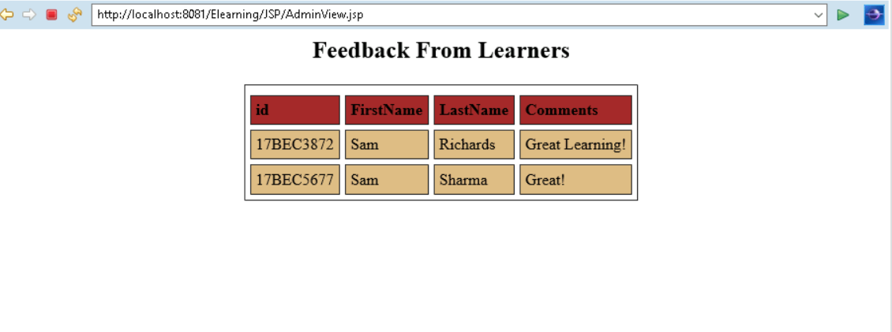
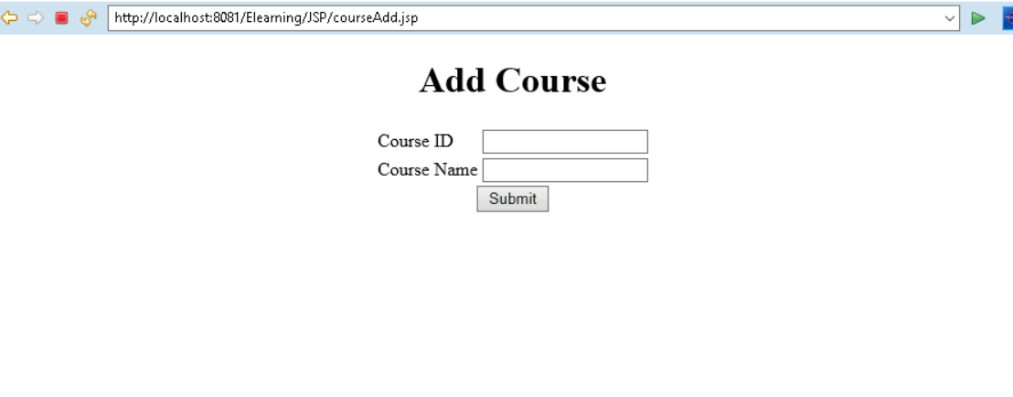
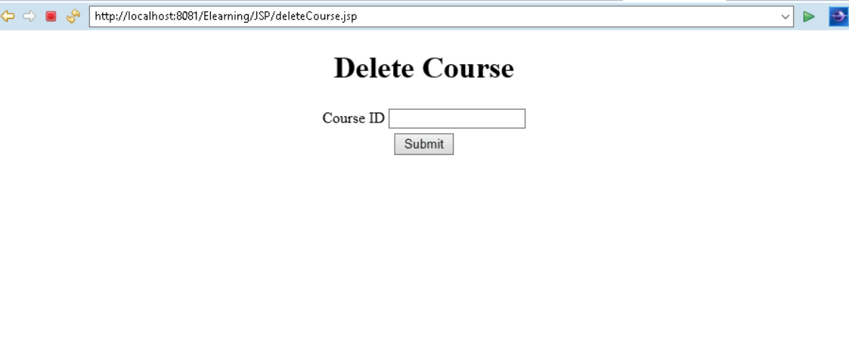
Admin’s View Feedback Tab
Add Course and Delete CourseTab for Admin

Slide 7
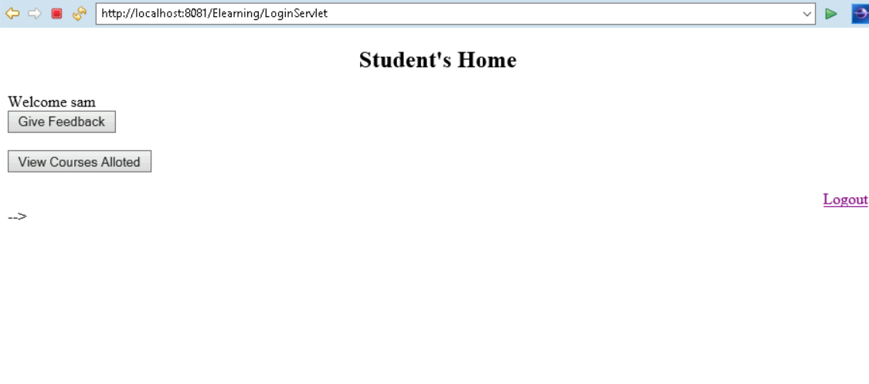
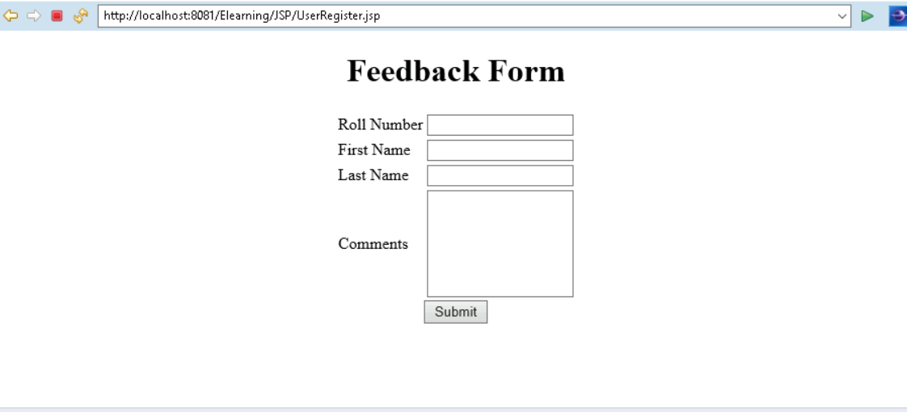
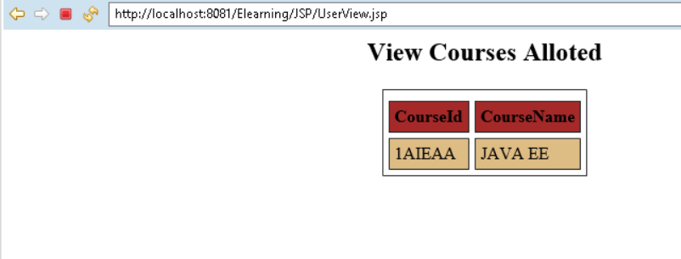
Student’s Dashboard
Give Feedback Tab for Students View Courses Allotted

